Slide 1
Container Registry System
The Starks
Ganesh Taduri
Aparna Pamidi
Harsha Komalla

Slide 2
Use Case:
Create a simple container service. The system consists of a container registry, and a compute infrastructure on which the container images will be hosted/deployed, and a controller to manage the provisioning and deployment of the container images.
The controller monitors the health and uptime of the compute resources by the deployed containers and bills the customer accordingly

Slide 3
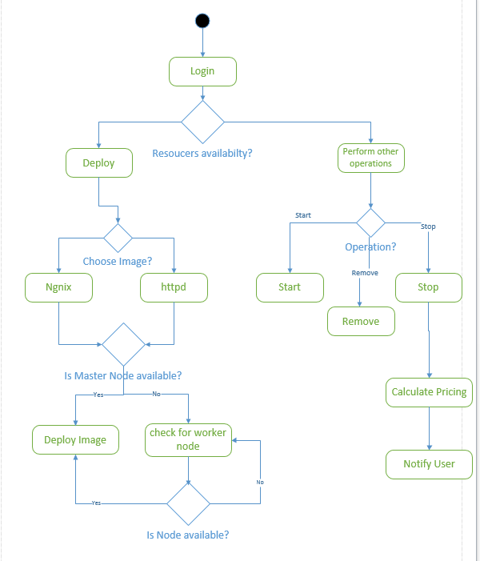
System Flow:

Slide 4
(continue..)
The registered client requests the Docker image to be installed
The registry system processes the client request and selects the node which is up and active to install the Docker image as requested by the client
Once the image got installed the controller checks the CPU processing time and RAM usage to calculate the price

Slide 5
References:
https://docs.docker.com/engine/userguide/
https://docs.docker.com/swarm/overview/
https://hub.docker.com/_/ubuntu/

